Slide 1
US Voting Trends by Major Societal Domains
Jeff, Victoria, José, Jing

Slide 2
Objectives and Questions
Are there observable political party voting trends based on major domains of society in the United States?
For example: How are major party voting trends associated with level of education?
We always see “Red” and “Blue” states, and some demographics
What about trends over the last few cycles?
What about other aspects of living?

Slide 3
Methods
Data Sources: US Census API, US Census County-Level Data Files
Variables
Race/Ethnicity, Education, Poverty, Unemployment, and lack of Health Insurance
County-level voting was categorized
“Red” or “Blue” if ≥ 52% of votes from that county went to Republicans or Democrats
“Split” if the breakdown was between 48-52% for the parties (too close to call)
“Party Leaning” perspectives
Composite voting based on average voting across 2008-2016 elections
Election-cycle voting for 2008, 2012, and 2016 elections
BONUS: We generated an example state-level analysis to reveal the other dimensions of analysis capable within this dataset

Slide 4
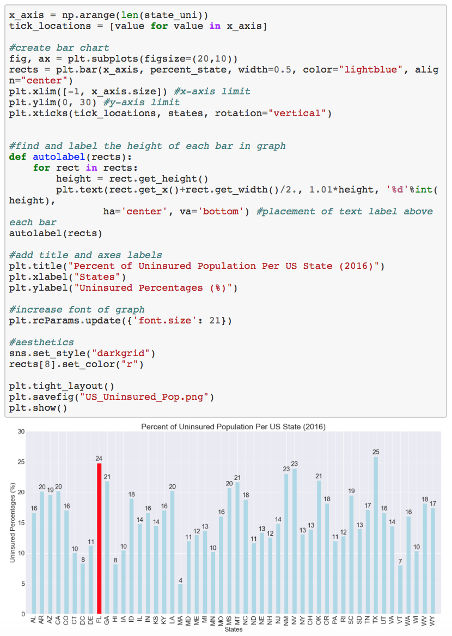
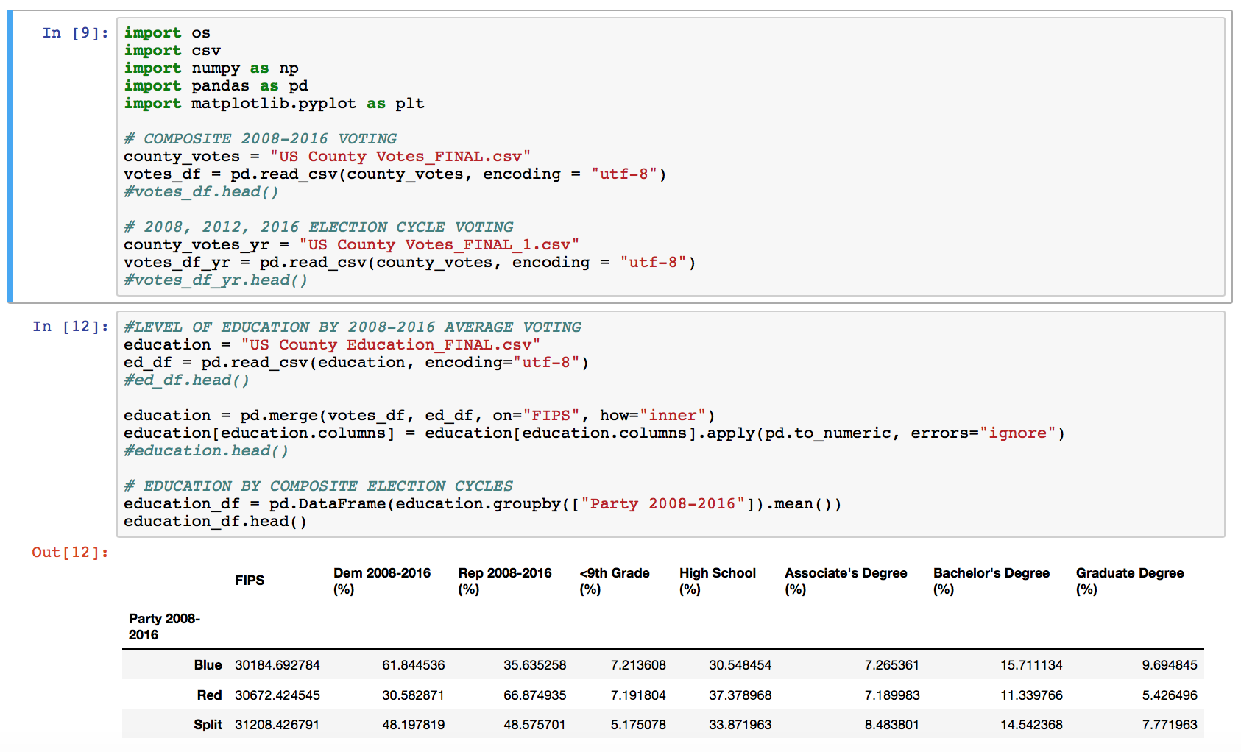
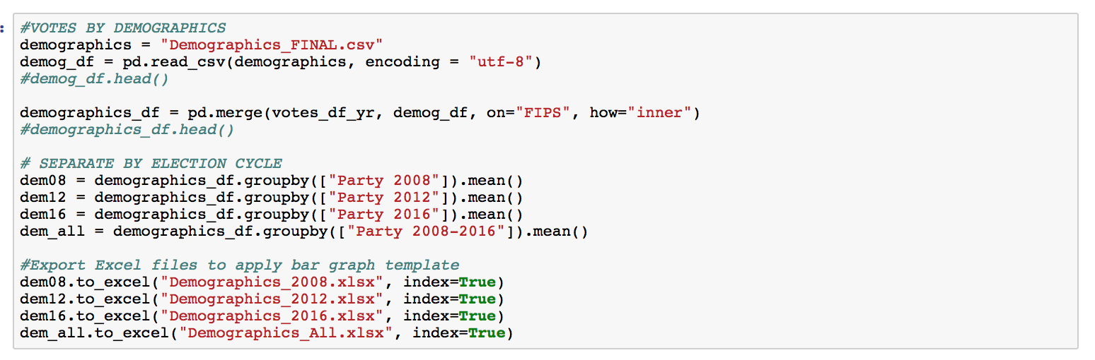
Some of the Code
Compiling voting and education by county: “Blue,” “Red,” “Split”
(All files merged based on county FIPS code)
Grouping by election cycle year and exporting to Excel
Generating state-level analytics

Slide 5
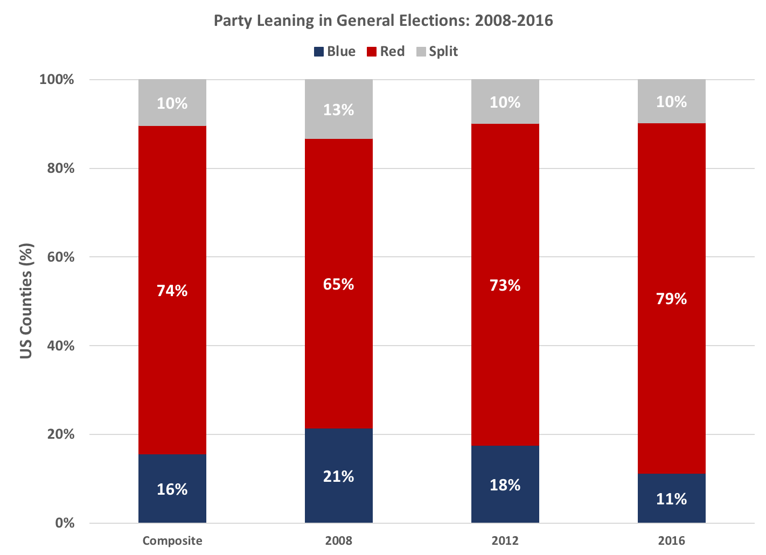
The Long View: More Counties Went Red in 2016
FLAT
+14% INCREASE
-10% DECREASE

Slide 6
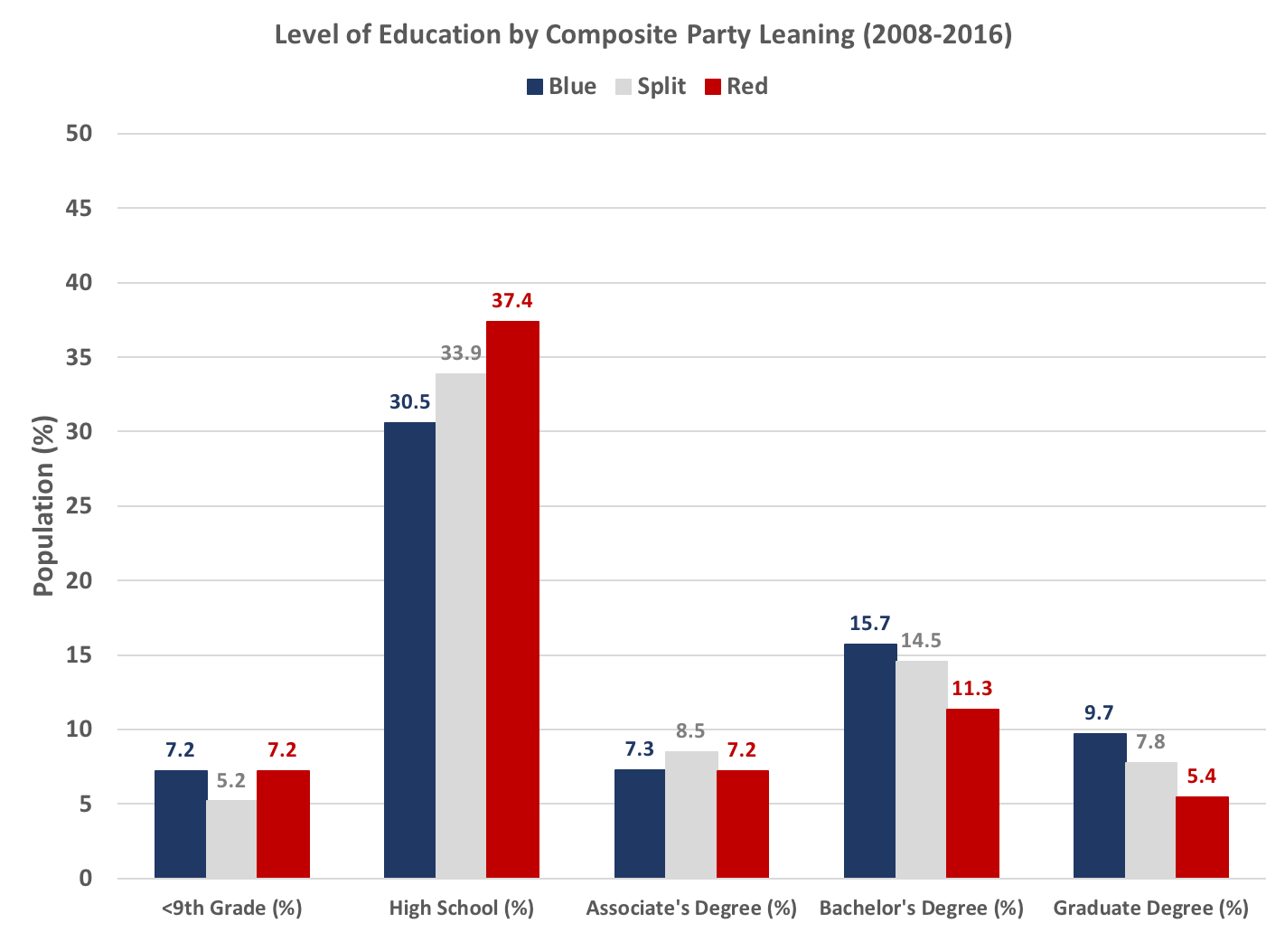
Higher Education More Often Blue

Slide 7
Demographics

Slide 8
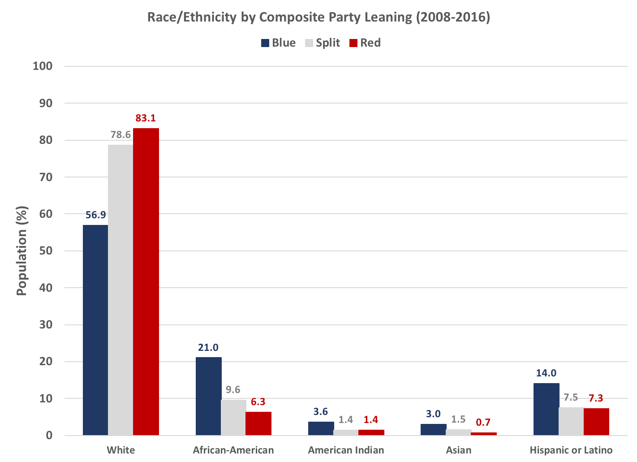
Whites tended to be Split/Red, Minorities Blue

Slide 9
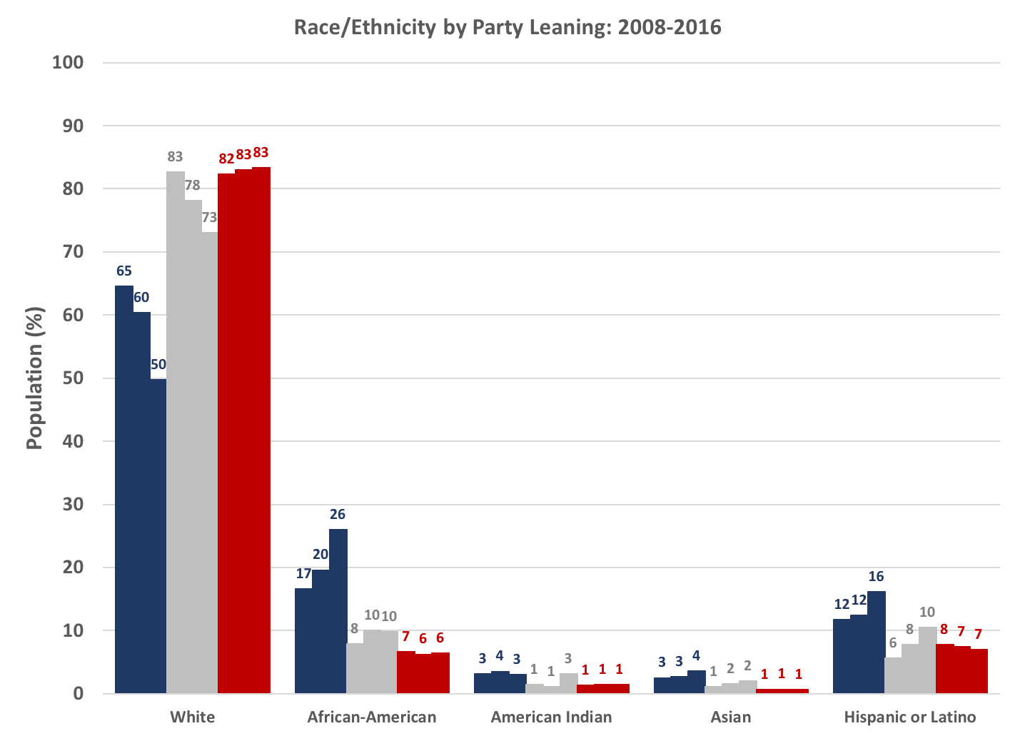
Breakdown: Fewer Whites, More Minorities among Blue Counties

Slide 10
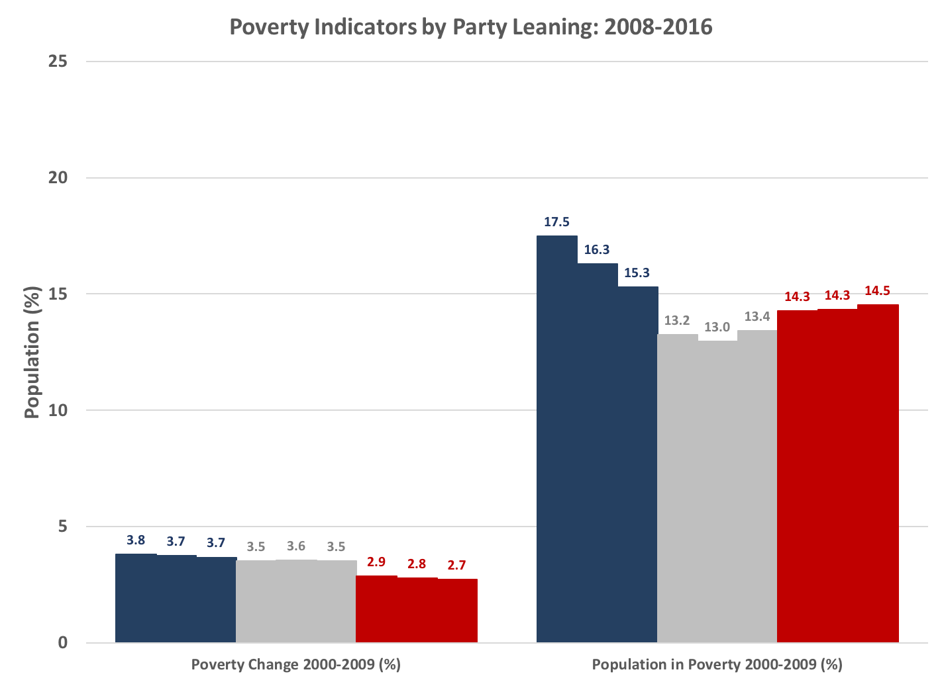
More, Decreasing Poverty among Blue Counties
Notes:
Poverty
Here we looked at the historical proportion of the population in poverty for Blue, Red, and Split counties 2000-2009. We calculated the average percentage of each county’s population in poverty across 2000-2009. These estimates were then aligned with the county’s majority voting as Blue, Red or Split in the 2008, 2012 and 2016 General Election cycles.
The bar graph on the LEFT shows how the poverty change from 2000 to 2009 was +3.7% among counties voting Blue 2008-2012, and approximately +2.8% among those voting Red in the same elections. Overall, poverty increased more among Blue counties than among Red counties (no statistical testing applied).
The bar graph on the RIGHT shows how the proportion of people in poverty decreased among Blue counties from 2008 to 2016. This may have been due to a true reduction in poverty levels among these Blue counties, or to a smaller share of counties voting Blue in 2012 and 2016.

Slide 11
Unemployment

Slide 12
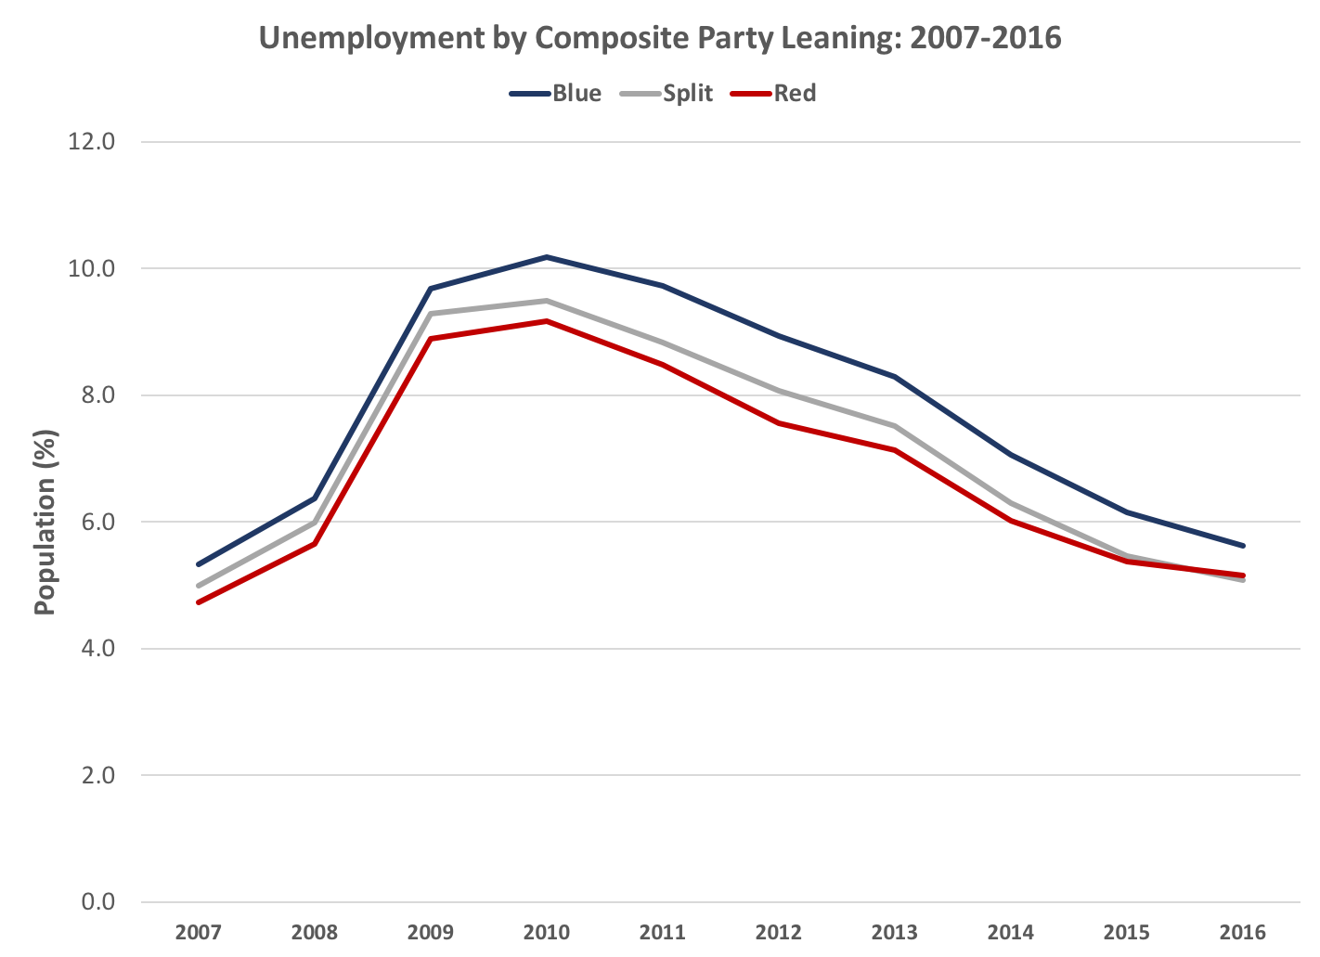
Unemployment higher among Blue Counties
Notes:
Unemployment
Here we calculated the unemployment rates for counties voting Blue, Red or Split

Slide 13
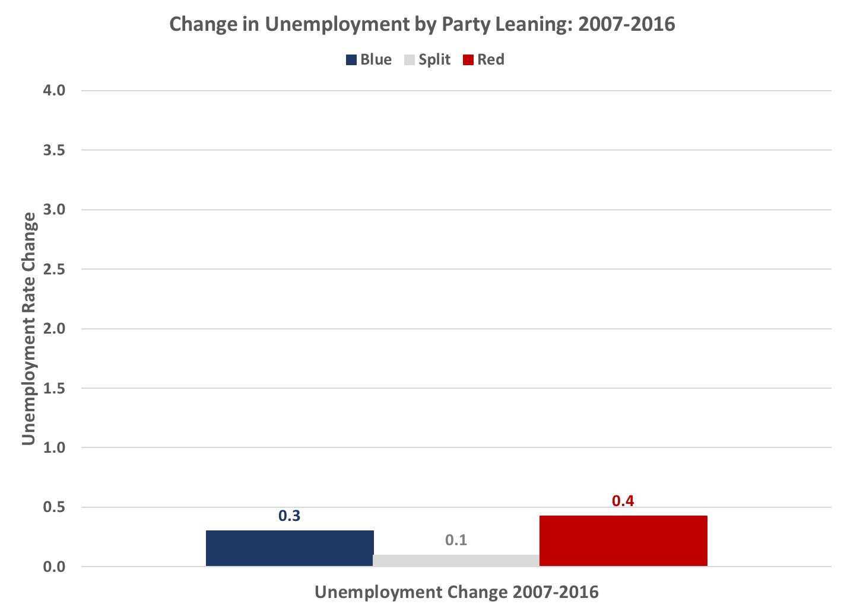
Similar Changes in Unemployment: 2007-2016

Slide 14
Health Insurance

Slide 15
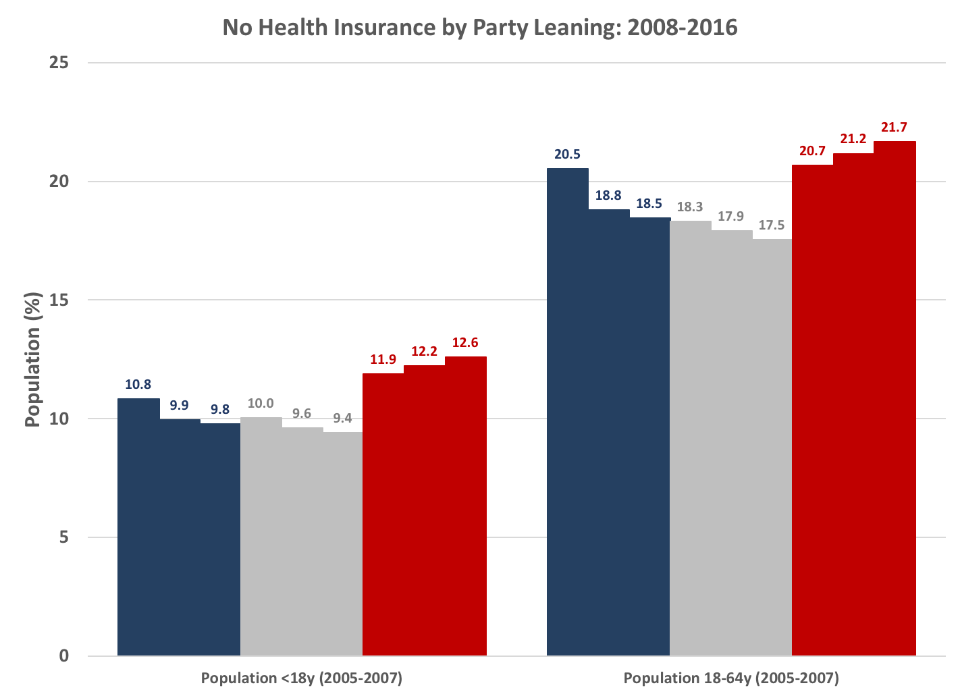
Less Health Insurance among Red Counties

Slide 16
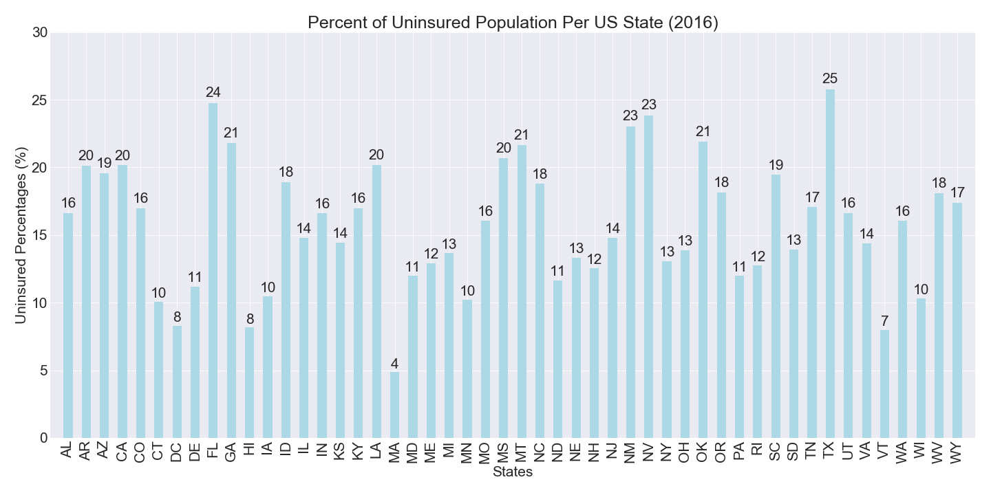
Health Insurance Nationwide

Slide 17
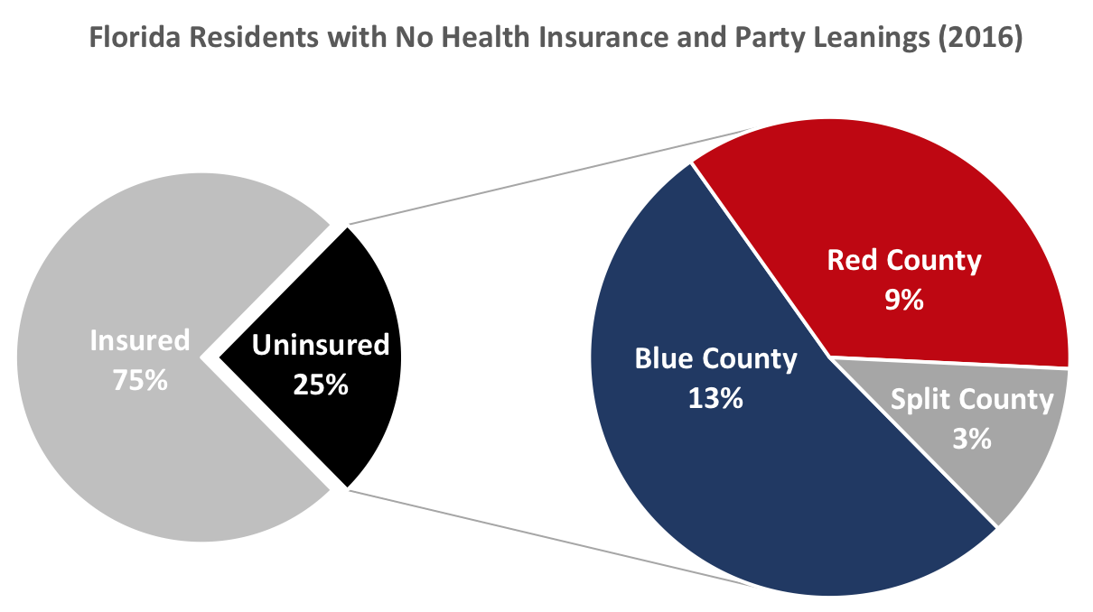
State-Level Analysis: Health Insurance in Florida

Slide 18
Thank you

